Slide 1
ANALYSIS OF RULE BASED MODELS
Spencer Purves

Slide 2
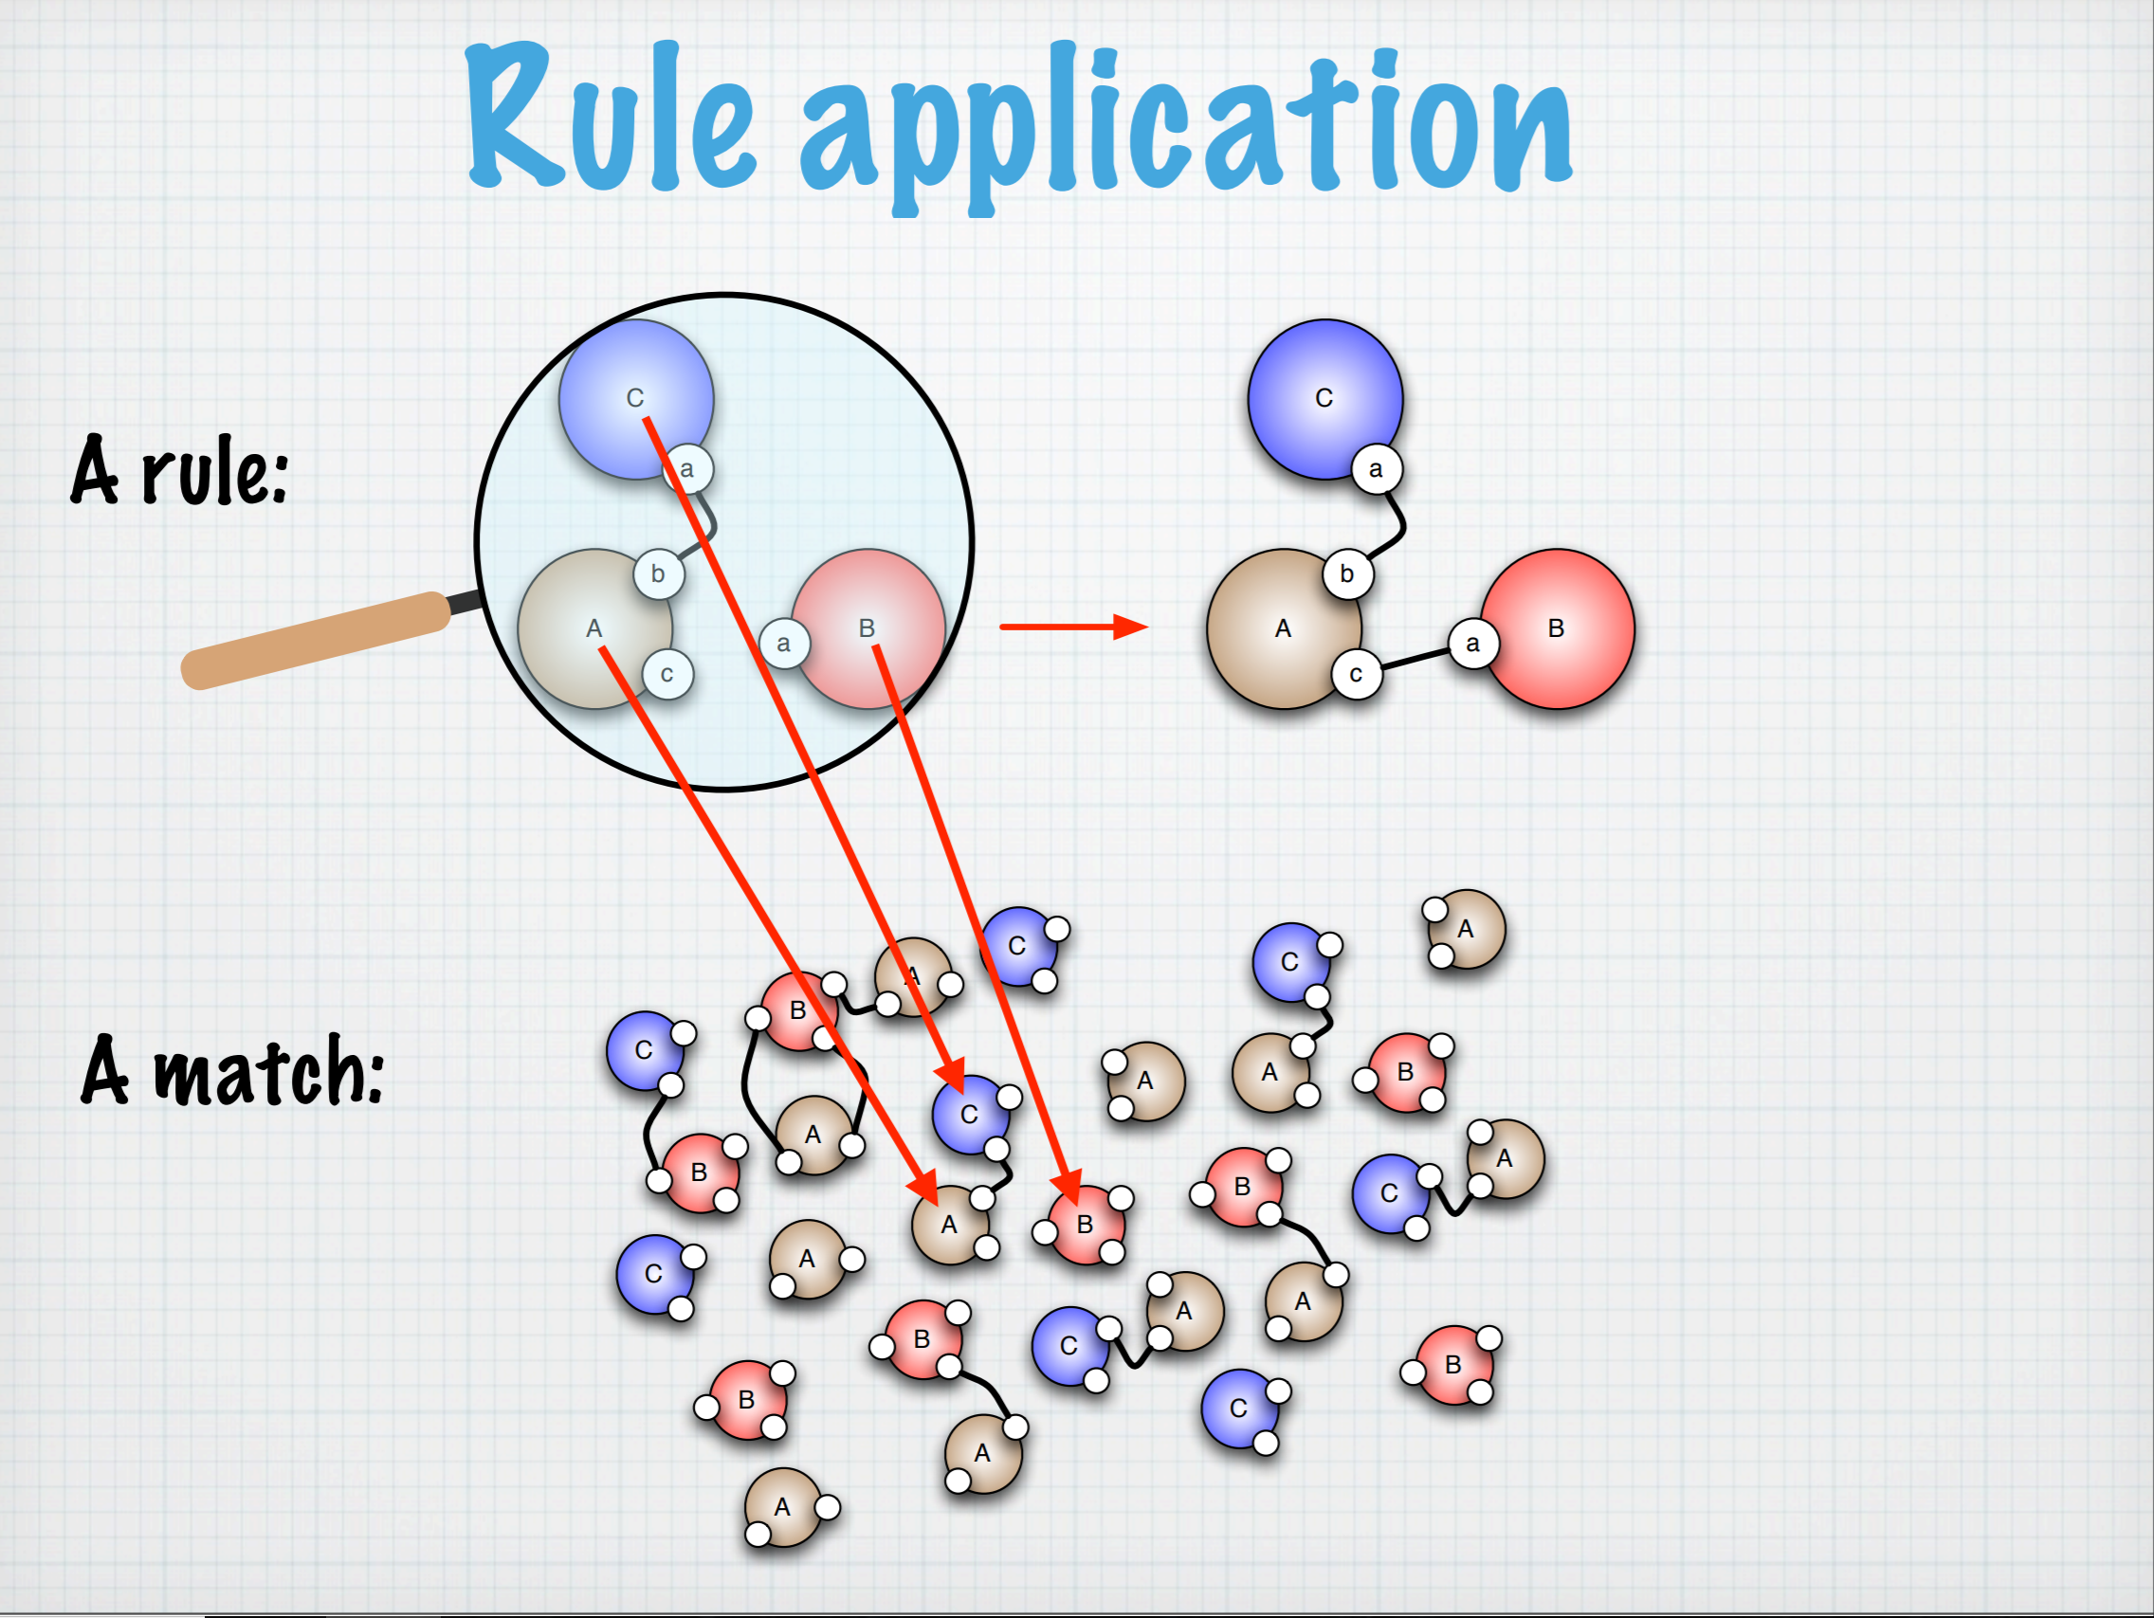
What is a rule based model?
Just as it sounds – a model based on a set of rules
Rules govern the reactions of molecules in the cellular system

Slide 3
Why?
Developed to help model complex cellular functions like signaling networks, transcription networks and metabolic networks
Models can help understand outcomes and assist in outcome prediction
Molecules with multiple binding sites and many possible interactions per site have intractable combinatorial complexity
This complexity can be expressed more reasonably through a set of rules that define the interactions of the molecules

Slide 4
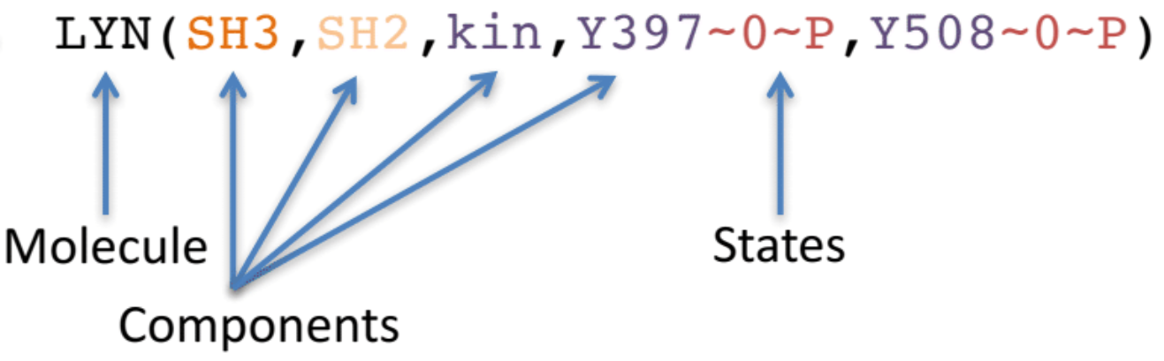

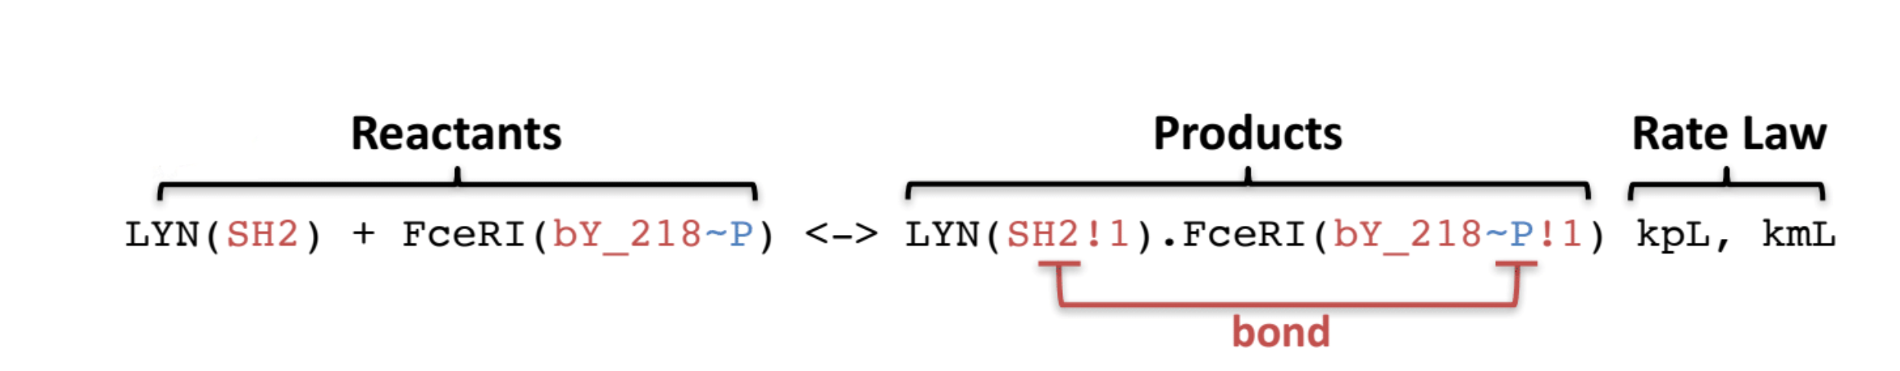

RULE: LYN SH2 domain binds to phosphorylated Tyr 218 on the $β$subunit of FceRI
Elements not specified can be in any state

Slide 5
My Project
Main Goal: to create software to model and analyze rule based models
Use currently available software to create a rule based model
Export model to a SBML file
Using Python and the libSBML library import the rule based model SBML file
Extract necessary information from the file like rate constants, parameters, molecules, species, rules and reactions.
Use extracted model information to analyze and simulate the model using ODE and SSA methods

Slide 6
BioNetGen and RuleBender
BioNetGen is software to specify and define a rule based model
RuleBender is a tool to simulate and visualize BioNetGen file

Slide 7
SBML file

